Slide 1

07. Seerat of
Holy Prophet (S.A.W.W) I
(Conditions of Hijjaz & Family and Background )
Course Instructor
Islamic Studies:
Mufti Omer Rafiq

Slide 2
LIFE OF HOLY PROPHET(S.A.W) AT MAKKAH Conditions of Hijjaz: 1) Forget their religion. 2) Totally darkness. 3) Tampared with their religion. 4) Christian and jews lost their religions and actual books. 5) Tawaf without clothes. 6) Burying thegirls alive. Family and Background: Birth, Sucking and fostering, at the Age of five years, six years, eight years. Journey to Syria: At the age of twelve, accompanied with Hazrat Abu Talib for trade journey to Syria, Christian Monk Buhaira recognized him at Basra by some of his signs as last Prophet(S.A.W)

Slide 3
Halfulfazul: (Oath of fazool)
At the age of 20 years, Holy Prophet SAW participated in an oath which is known as Halfulfazool.
The oath was taken by different tribes to help the oppressed people against the oppressors. To give the rights and properties back to the oppressed people.
The name of this oath is fazool because the first word of the leader of every tribe started with fazal.
Marriage:
At the age of 25 years, Holy Prophet SAW went to syria again to take the merchandize of the rich widow for business
The slave Maisrah of Hazrat Khadija accompanied Holy Prophet.

Slide 4
Hazrat Khadija became very much impressed by the honesty of Holy prophet, she offered her hand for marriage.
At the time of marriage, the age Holy Prophet SAW was 25 years and Hazrat Khadija was 40 years old.
RENOVATION OF KA’ABA:
When the age of Holy Prophet SAW was 35 years, all the tribes of Quraish started renovation of Kabatullah and every tribe took part in this renovation. There was a huge dispute among the tribes for the placement of Hajr-e-Aswad. This dispute was finished by Holy Prophet (S.A.W), When he placed the black stone on a sheet and the chief of every tribe hold the corner of sheet and Holy Prophet(S.A.W) placed this stone on its actual place.

Slide 5
FIRST REVEALATION:
Holy prophet(S.A.W) from his age 35 to 40 started to go to a cave named, Hira not far from Makkah for the spiritual meditation/arbitration. As one night when his age was 40 an angel Hazrat-e-Jibriel appeared before him and said ‘’Read’’. Hazrat-e-Jibriel was in the shape of human being. Holy Prophet(S.A.W) has said ‘’I could not read’’ Hazrat-e-Jibriel closed him in his hands and Holy prophet( S.A.W) started to read. This was the first revealation revealed on Holy Prophet(S.A.W). He was very anxious and his wife Hazrat-e-Khadija took him towards his cousin Warqa-bin-Nofal who assured him that, He is the last prophet and Allah will protect him.

Slide 6
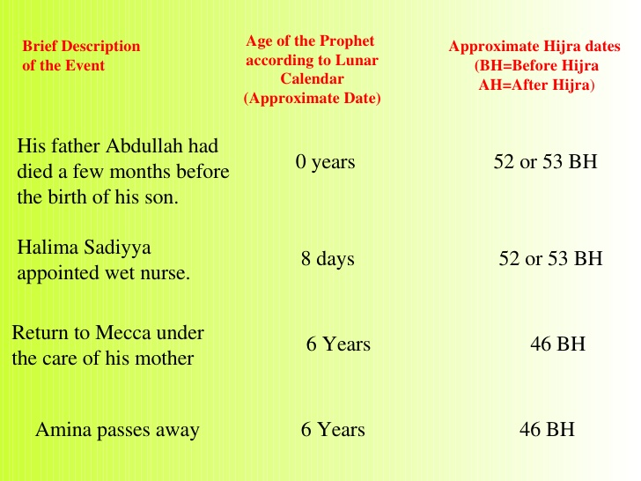

Slide 7
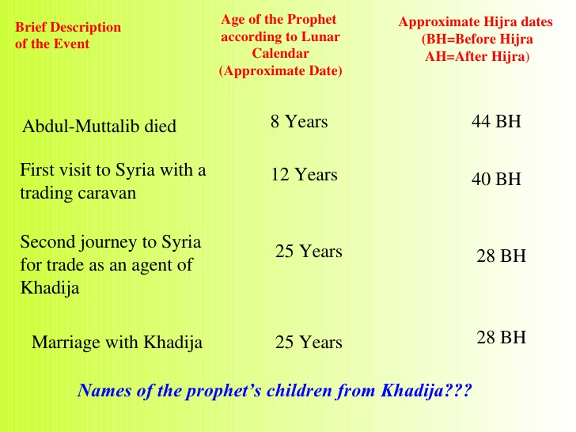

Slide 8
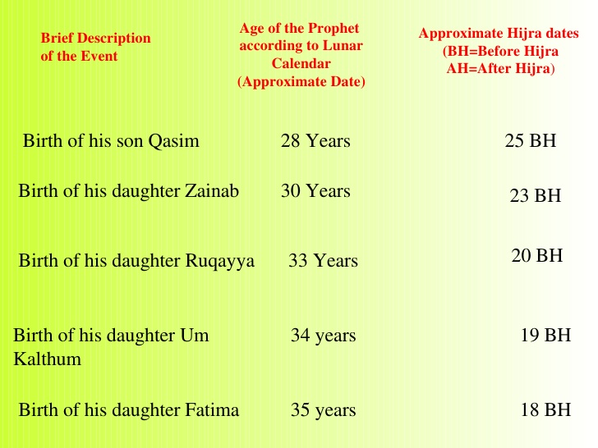

Slide 9
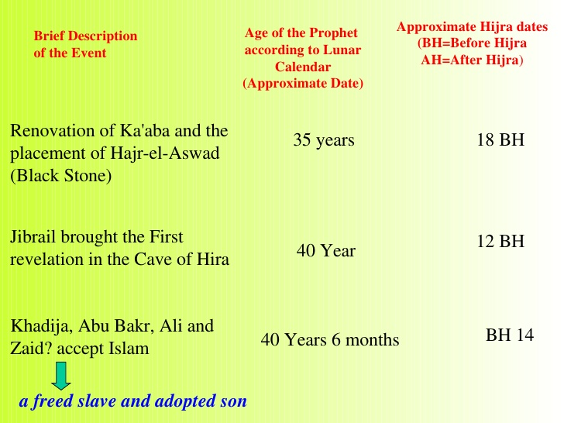

Slide 10
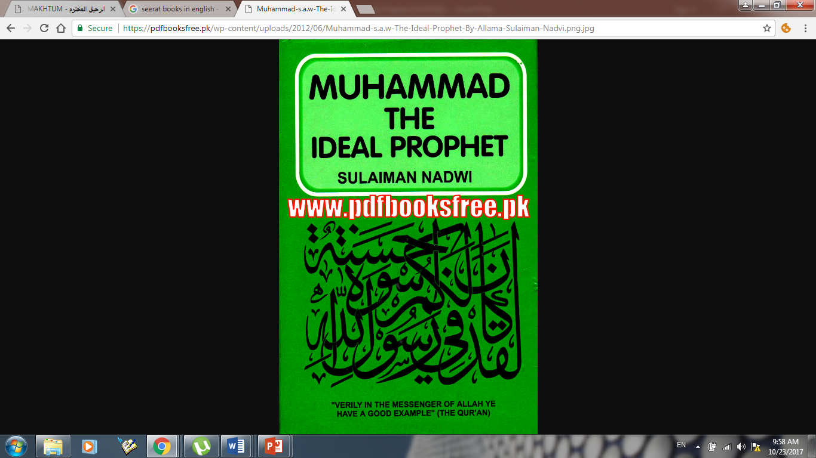

Slide 11
